Slide 1

Tesco Operating Model
Finance – Lisa Baglin
June 2006
Notes:
1

Slide 2
Finance - Executive Summary
Finance covers:
  Managing the accounting of Fixed Assets & the appraisal of these investments
  Managing the accounting of the working capital (accounts payable, accounts receivable, stock & cash) of the Business
  Reporting the company’s financial performance at any given time
The key benefits are that:
  We comply with the local & group legal & fiscal requirements
  We safeguard the Company’s cash position by managing our working capital tightly and by maintaining strong governance over capital investment
  We report simple, accurate information to the Business to ensure effective decision making
  Our processes are as automated as possible & simple for our staff to follow
Our main dependencies are with:
  Commercial: to ensure we have the right information to ensure accurate payment to authorised suppliers and value goods received, returned & transferred correctly
  All Head Office Functions: to ensure Purchase Orders are raised & Invoices are authorised appropriately
  Governance Committee (I.e IODG) : to ensure that we have adherence to the capital approval process
  Store operations: to ensure we have accurate sales & tender information
Key decisions to be made include:
  What is the group best practice for Invoice Matching (are we going to include self billing as an option ?) ?
  Where should the transaction processing within the Finance Function sit ?
  How will we ensure governance over the Tesco Operating Model in the USA (more of a risk than a decision !) ?
Notes:
2

Slide 3
Benefits
Account for fixed assets
  We ensure approval from the relevant governance committee before monies are committed;
  We report accurately all the companies assets for internal & statutory purposes;
  We have the information to enable us to manage the profit impact of movements in asset values
  We have a simple automated process which is clear for all our staff to follow
Manage the costs of projects
  We can appraise the projects for their financial performance;
  We don’t waste time as we have 1 single source of data for all the budget holders;
  We understand our capital commitments going forward;
Maintain supplier details
  We ensure we have all the relevant information on suppliers in one place;
  We pay our suppliers for goods in accordance with the contractual agreement which allows us to manage cashflow;
  We ensure data entry is controlled to minimise opportunity for fraud;
Manage purchase & sales tax
  We comply with all local & group legal & fiscal requirements
  We make timely & accurate payments to Tax authorities.

Slide 4
Benefits
Raise Purchase orders for goods and services not for resale
  We ensure payment is only made to authorised suppliers;
  We have a simple, automated process which is clear for all our staff to follow;
Validating sales and tender movement (Sales Audit)
  We check any errors in sales on a daily basis;
  We protect our assets by reporting all the different tender types on a daily basis and tracking their movement
Manage currency
  We follow the Tesco Group Policy to purchase in the local currency wherever possible;
  We plan the foreign currency requirements so that Treasury can maximise any forex opportunity;
Valuation of goods received, returned and transferred
  We continually update the weighted average cost of our products to ensure we understand our operating margin;
  We make timely adjustments for any returns or transfers;

Slide 5
Benefits
Invoice Matching
  We only pay our suppliers the amount that we have approved which improves our working capital ;
  We have a simple, automated process which is clear for all our staff to follow;
Manage accounts payable
  We pay our suppliers on a timely basis
  We have a simple, automated process which is clear for all our staff to follow;
Manage accounts receivable
  We collect our debts quickly, reducing our bad debt risk & so improving the working capital for the business;
Manage stock ledger
  We can accurately report the cost of goods sold, the amount of stock on hand and the shrinkage we have incurred;
  We can use this information for reporting across the business.;
Manage General ledger
  We have an accurate picture of the companies financial position at any point in time;
  We comply with all local & group accounting requirements;

Slide 6
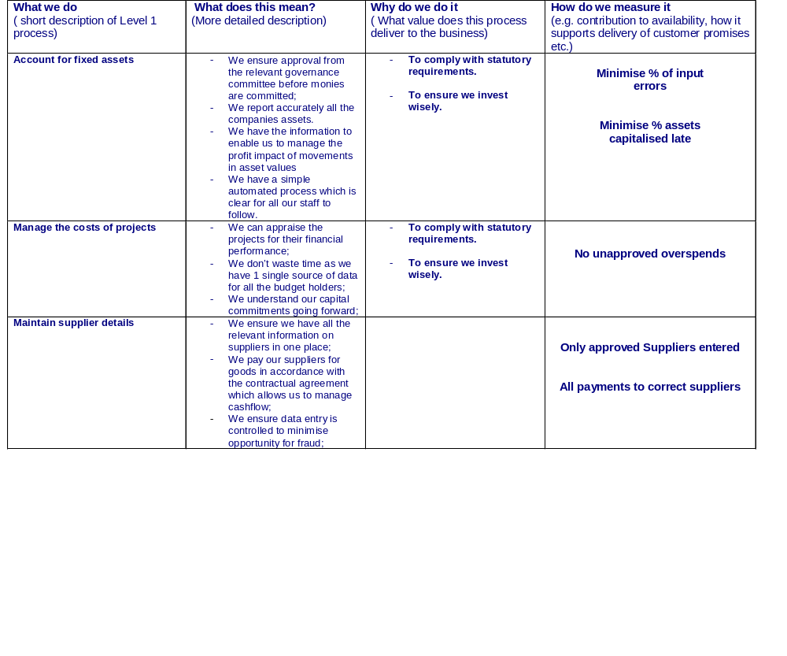
Finance Capability

Slide 7
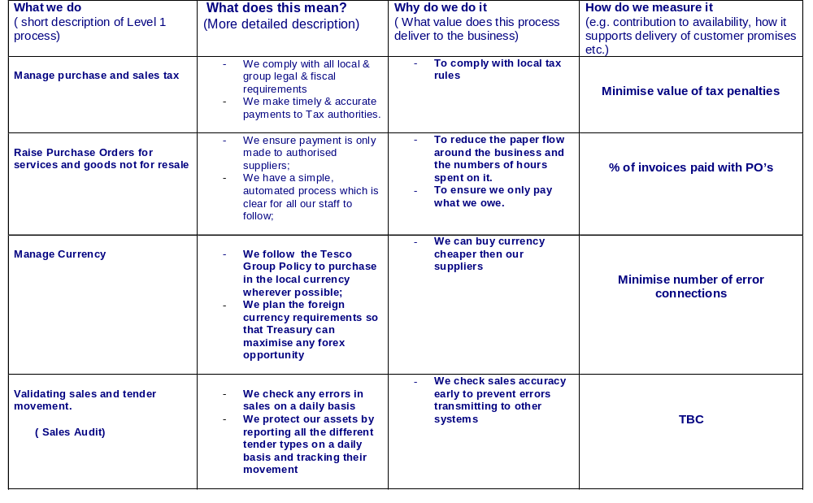
Finance Capability

Slide 8
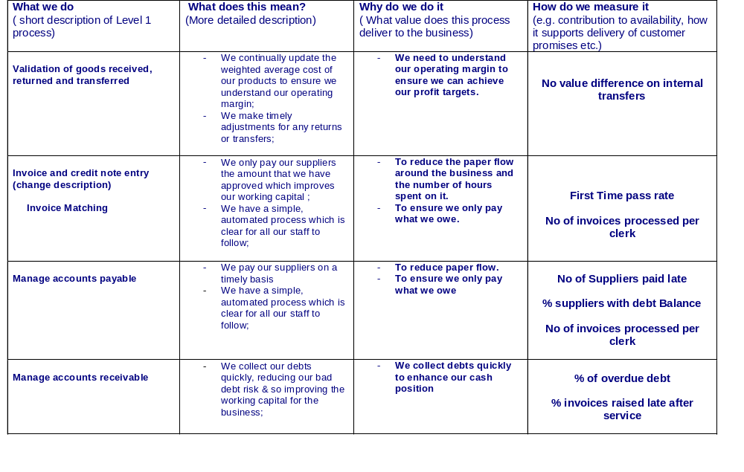
Finance Capability

Slide 9
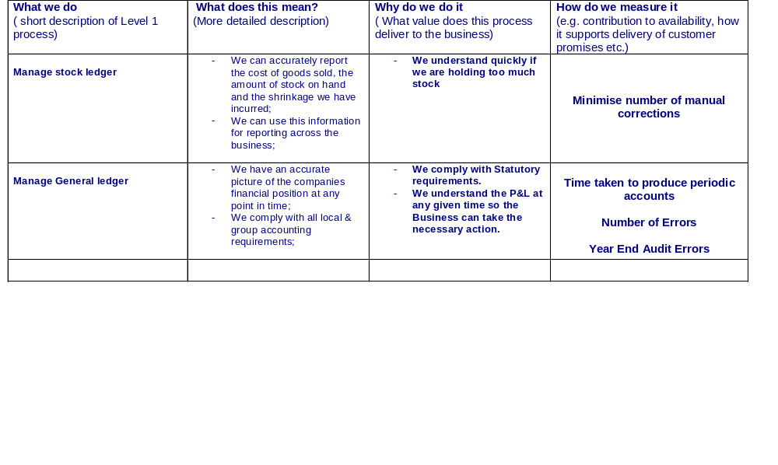
Finance Capability

Slide 10
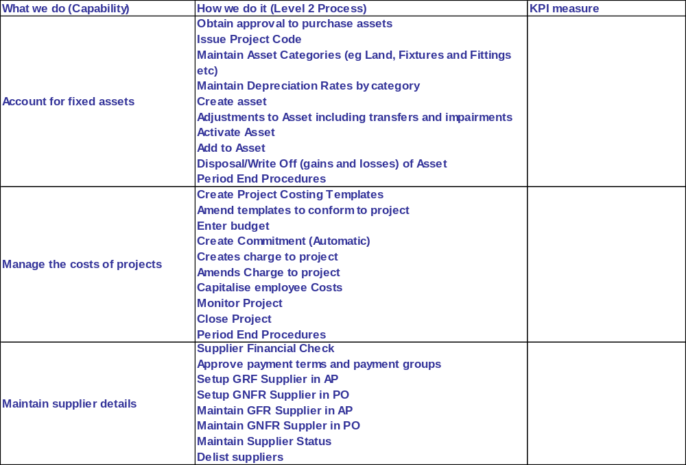
Capability
Minimise % of input
errors
Minimise % assets
capitalised late
No unapproved overspends
Only approved Suppliers
entered
All payments to correct
suppliers

Slide 11
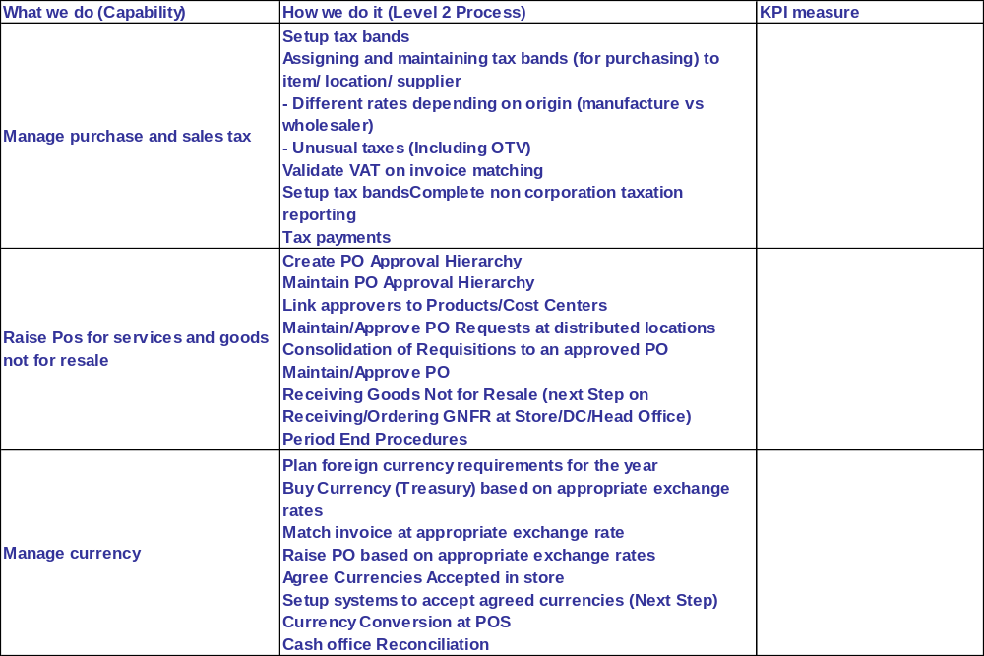
Capability
Minimise value of tax
penalties
% of invoices paid with
PO’s
Minimise number of error
connections

Slide 12
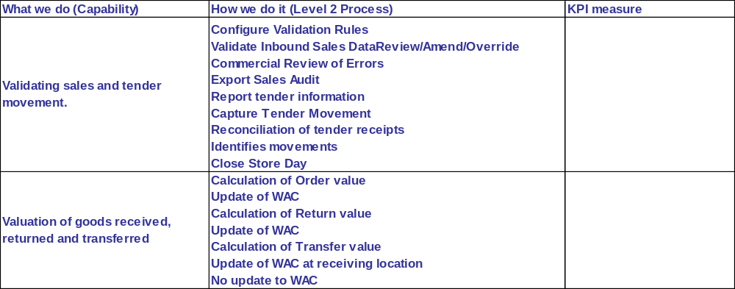
Capability
(Sales Audit)
No value difference on
internal transfers

Slide 13
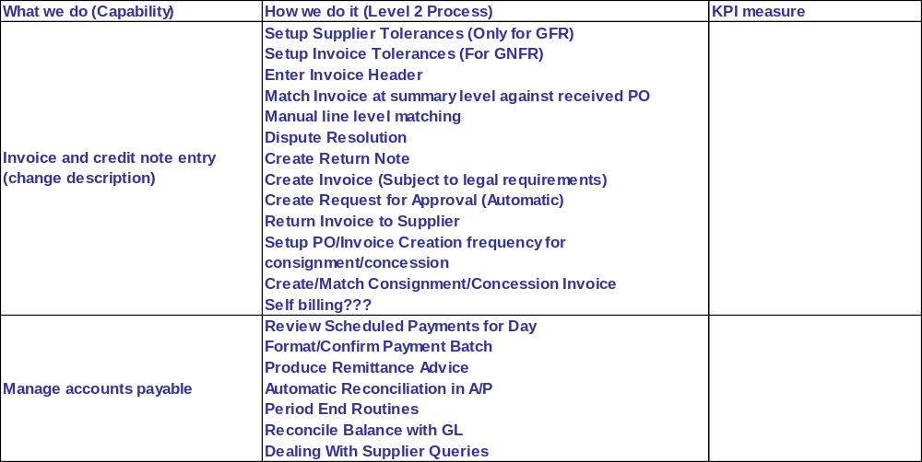
Capability
First Time pass rate
No of Invoices processed
per clerk
Invoice Matching
No of Suppliers paid late
% suppliers with debt
Balance
No of Invoices processed
per clerk

Slide 14
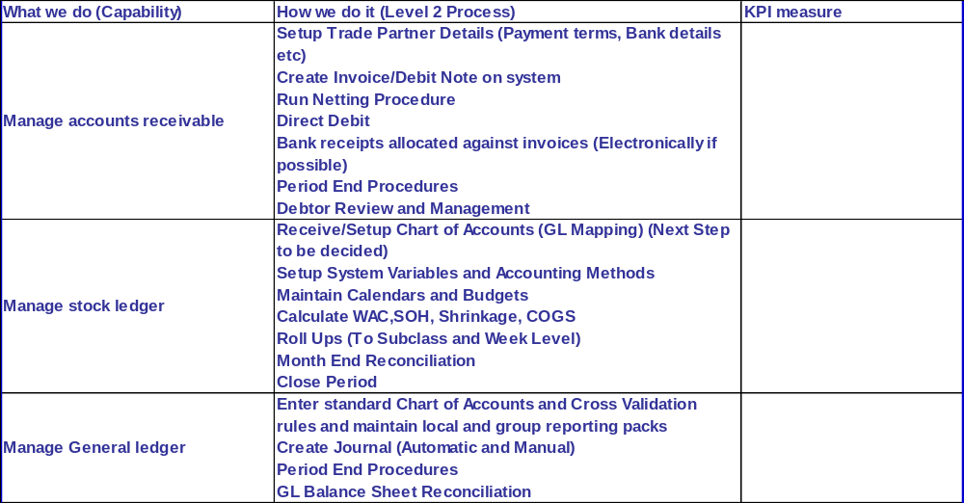
Capability
% of overdue debt
% invoices raised late after
service provided
Minimise number of manual
corrections
Time taken to produce
periodic accounts
Number of Errors
Year End Audit Errors

Slide 15
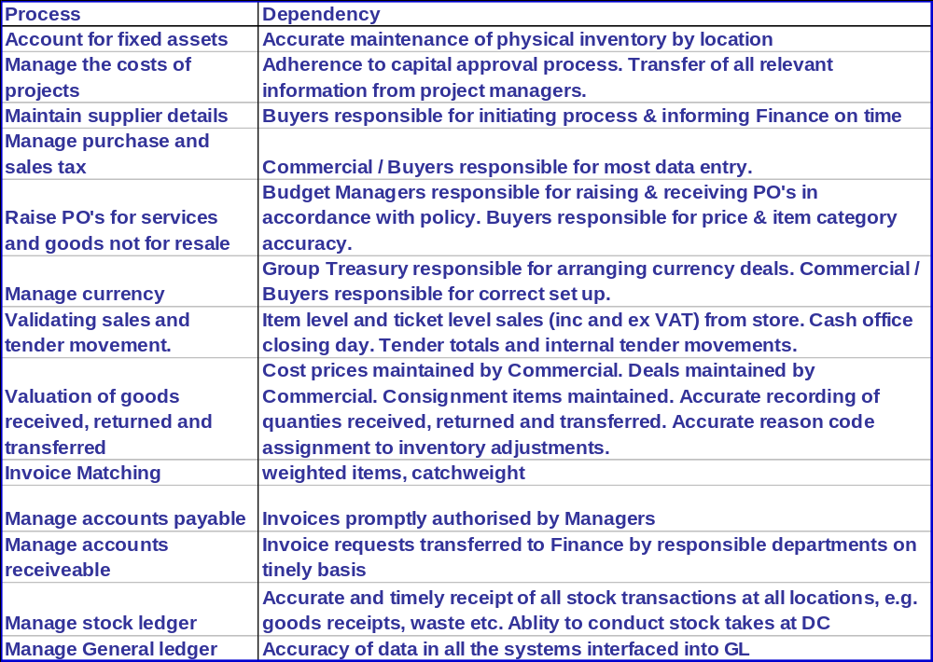
Interdependencies

Slide 16
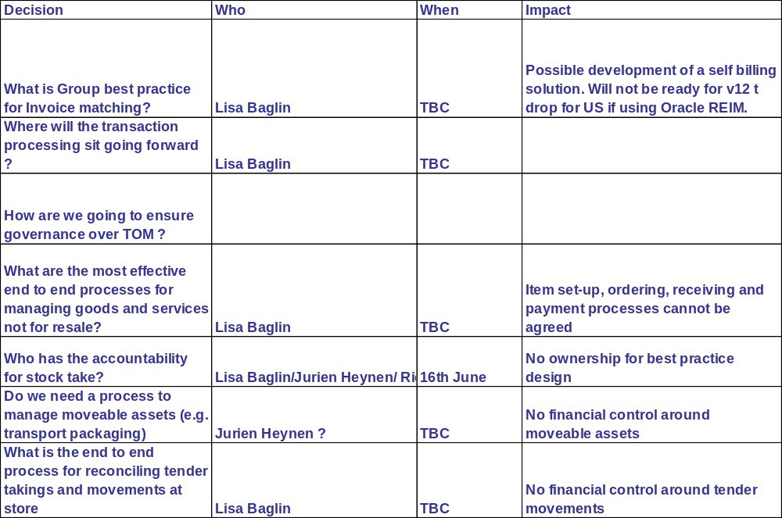
Key Decisions

Slide 17
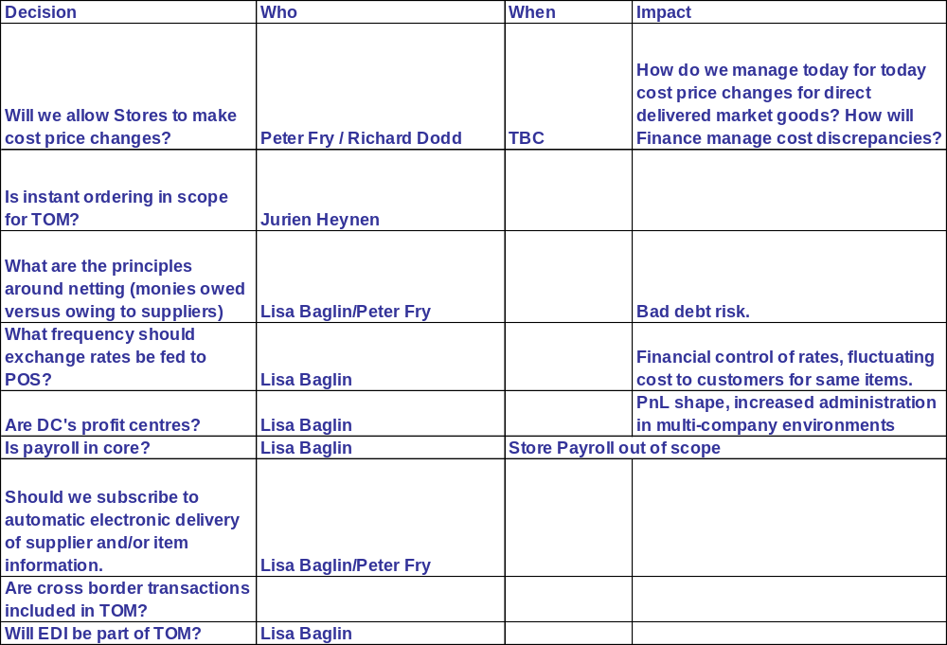
Key Decisions

